Slide 1
The Future of UX
What will UX be like 100 years from now?
Stephanie Rosenbaum
CEO, TecEd
UXPA 2014 London

Slide 2
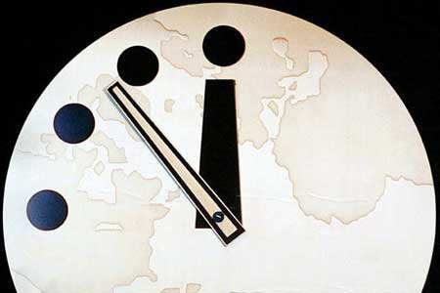
Which future? Utopian or Dystopian?

Slide 3
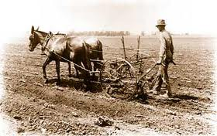
Dystopia
Back to medievalism?
Back to 1800?
Pockets of science?

Slide 4
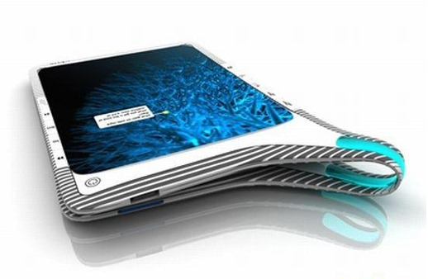
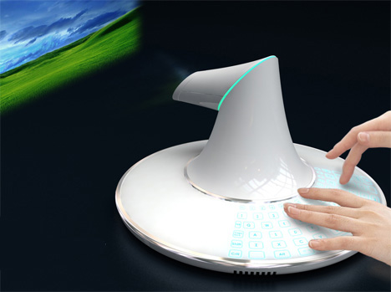
Utopia
Individual UX elements
Bio-machine integration
The Big Picture

Slide 5
What kinds of UIs?
Today
In the Future
Notes:
.

Slide 6
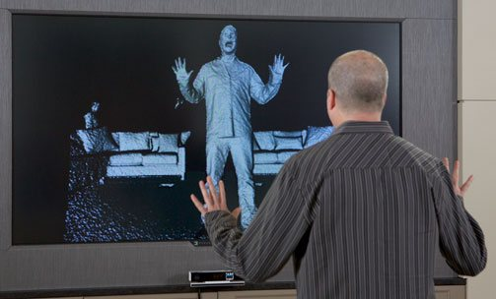
Today’s UI could be better
Touch
Vision
Position
Eyeball direction
Sound

Slide 7
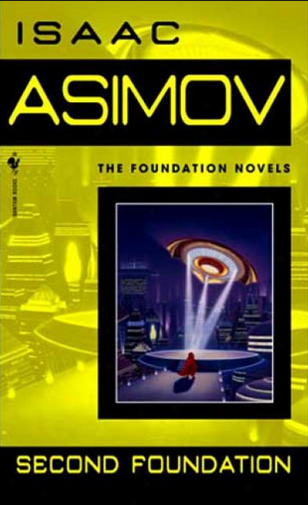
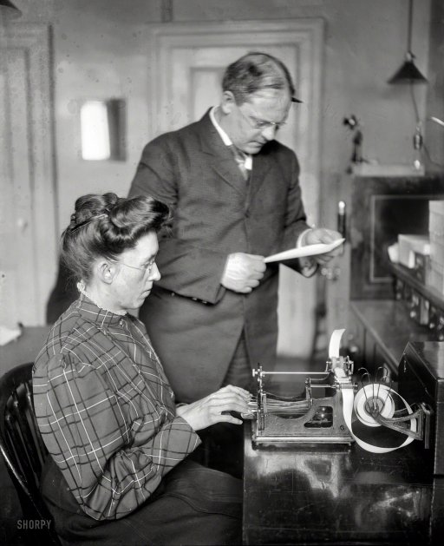
Natural Language
May need 100 years

Slide 8
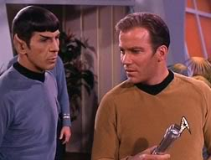
Fantasy or Reality?
Babel fish
Universal language translator
BOLT

Slide 9
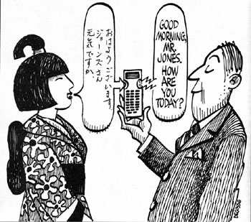
Multiple Languages
Moore’s law for language learning?

Slide 10
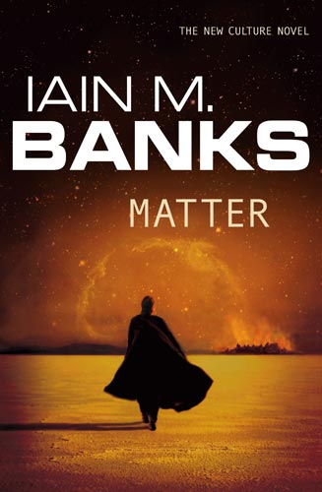
Future UIs could include
Smell
Blood pressure
Chemical products

Slide 11
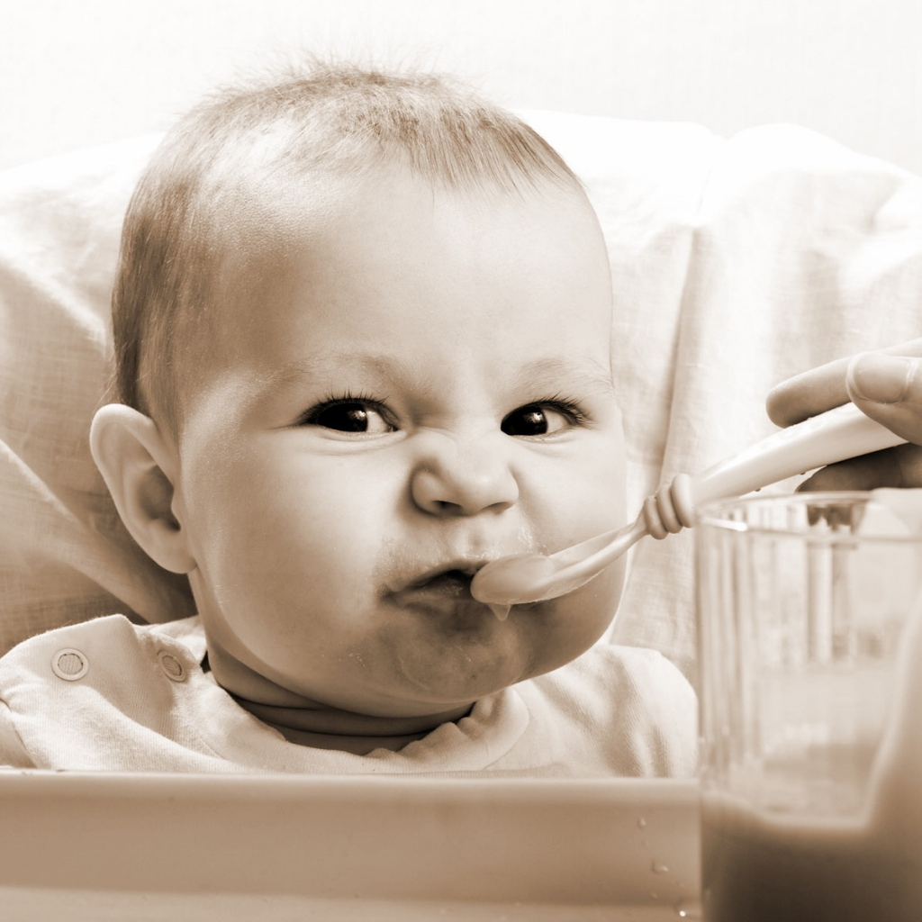
More Future UIs
Taste
Pain
Emotion

Slide 12
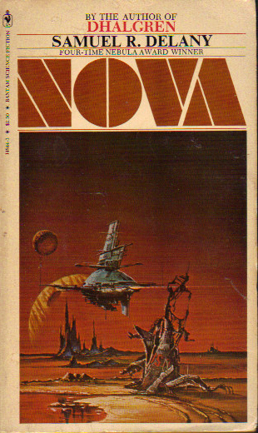
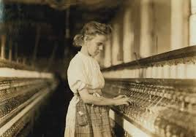
Electronic Nerve Interfaces
Coming soon

Slide 13
Sex via Computer
From games to teledildonics

Slide 14
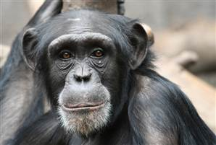
Blurring the Boundary
Is it alive?
Is it human?
Does it matter?

Slide 15
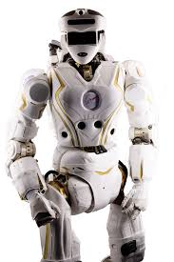
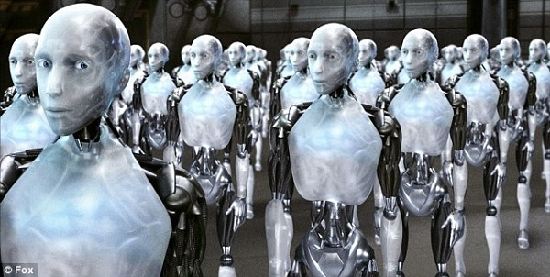
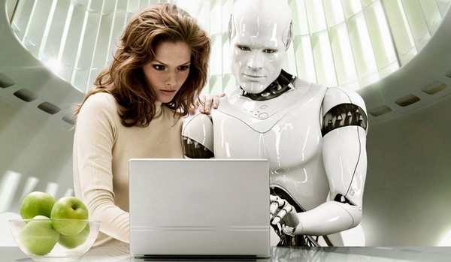
Inorganic Intelligence
The computer is conscious

Slide 16
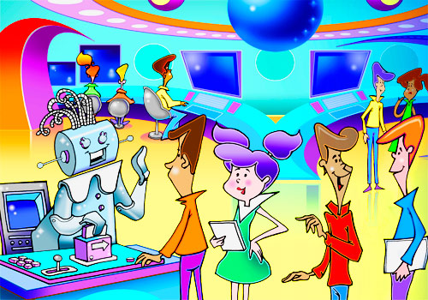
The Librarian
What will UX be like in 100 years?

Slide 17
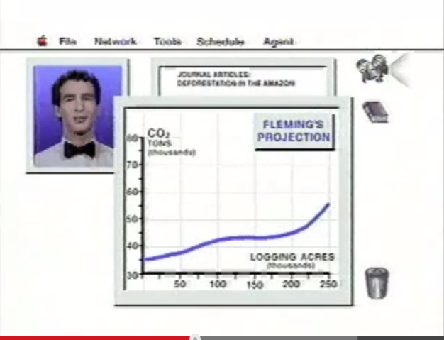
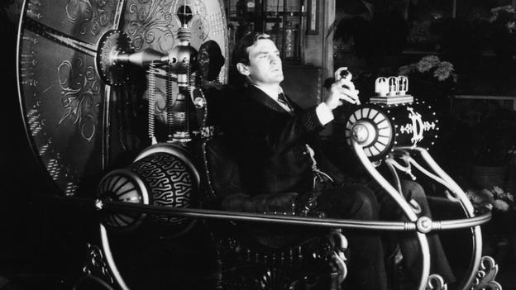
Our Assistant
Human knowledge not needed

Slide 18
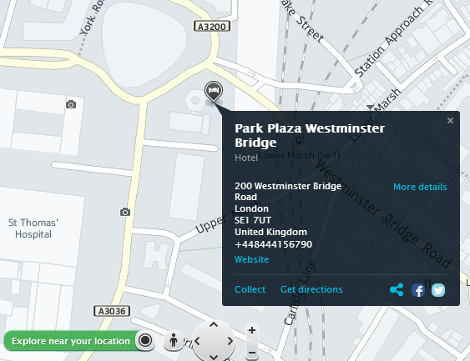
Map Apps for Everything
All the answers we want
What answers will we want?

Slide 19
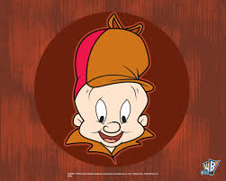
What Answers Will We Want?
Science, history, and art—or Facebook on steroids

Slide 20
The Future:
Looney-Tunes saw it first!
Thank you to all the scientists, science fiction fans, and critics who helped me with material for this talk, especially Whitfield Diffie, John Alden, Mike Ward, Karen Schaeffer, and Mark Baushke.

